Slide 1
Data Visualization using python
FMCG Everything
(Shounak Deshpande)

Slide 2
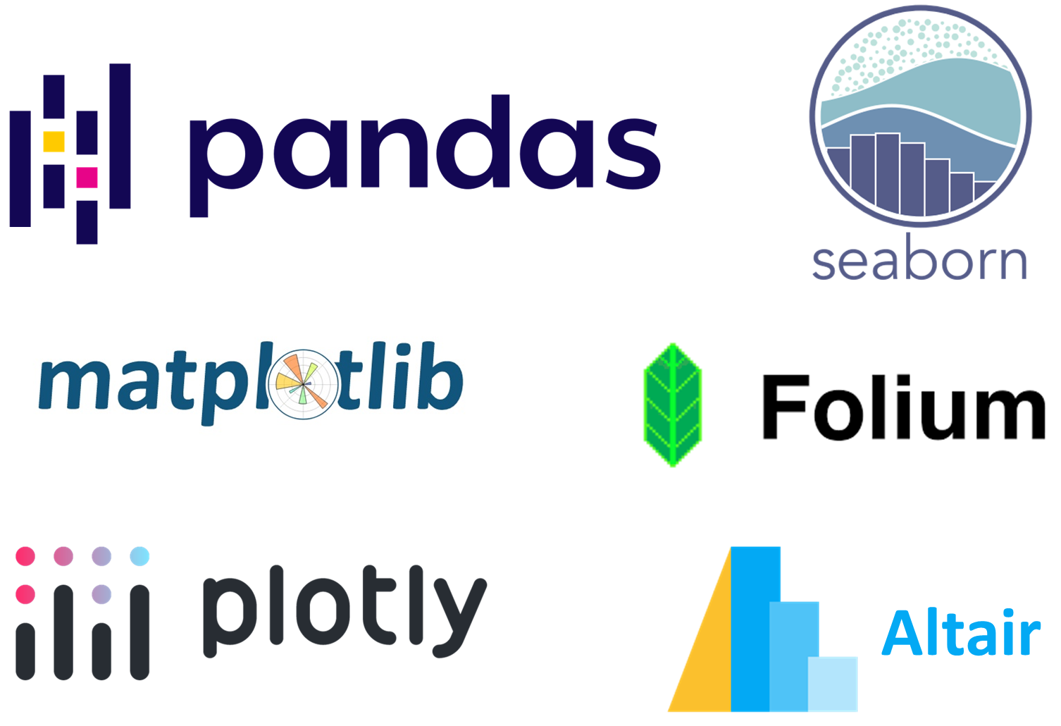
Libraries and Tools

Slide 3
Library/Tool Sequence
Matplotlib and Seaborn
Pandas
Plotly
Folium
Altair

